Slide 1


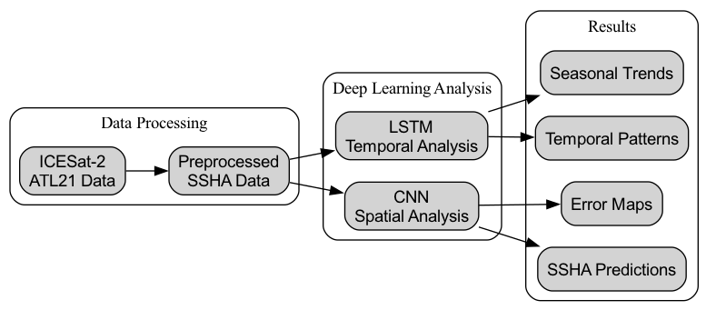
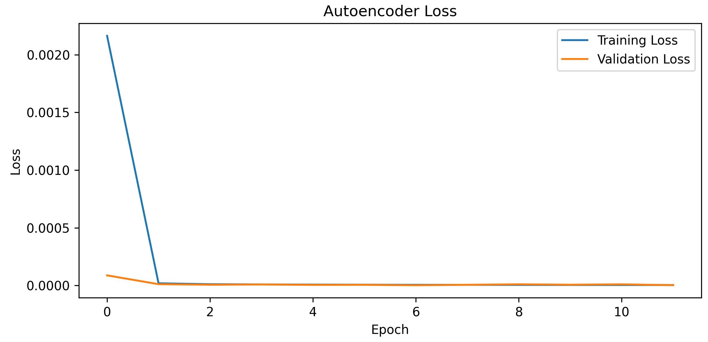
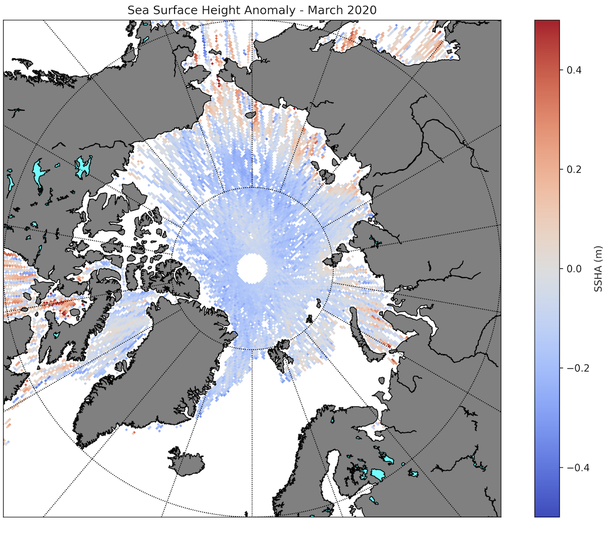
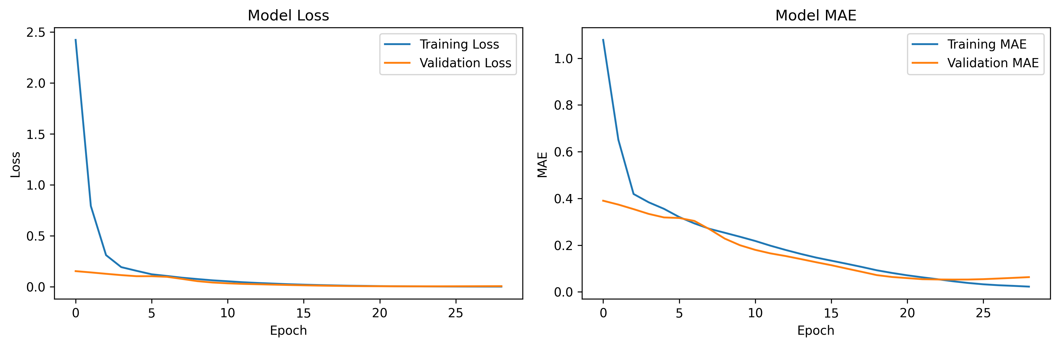
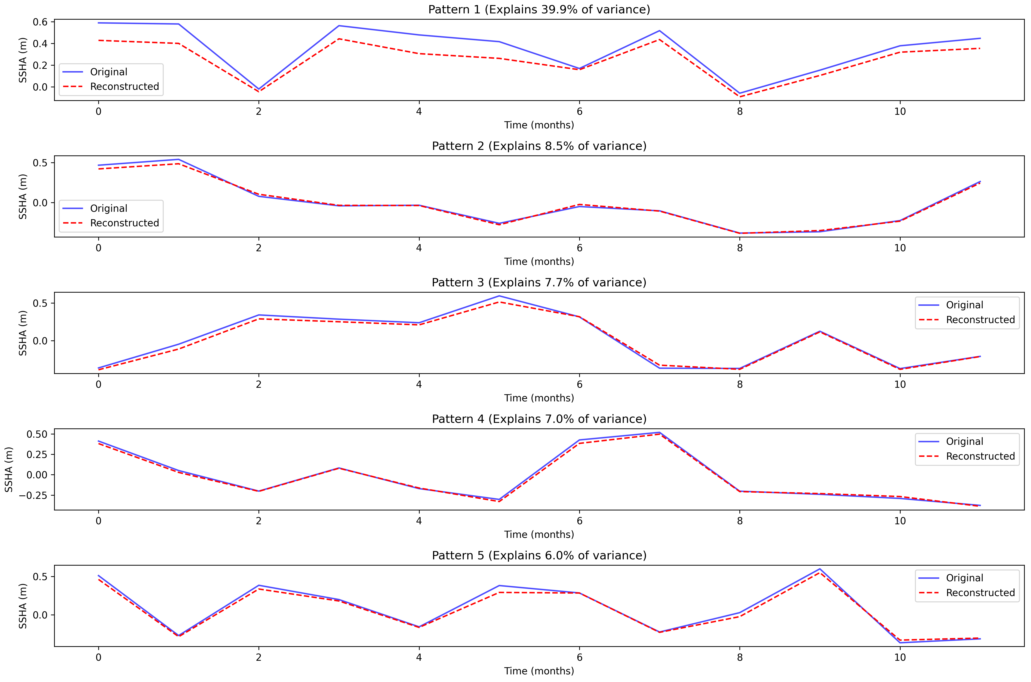
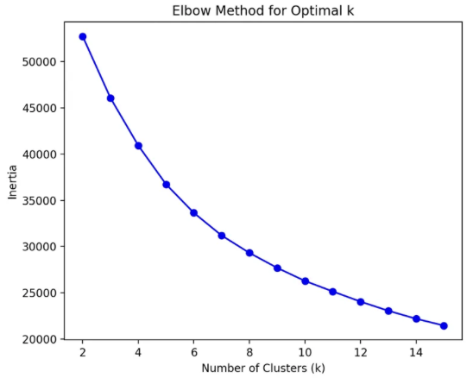
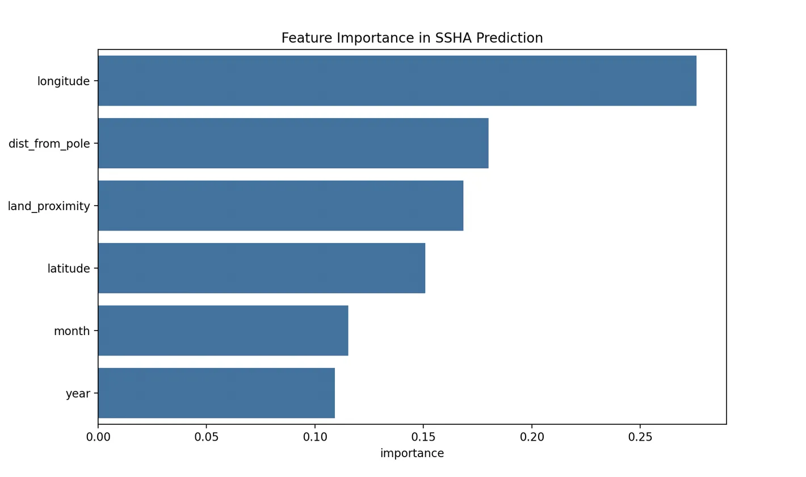
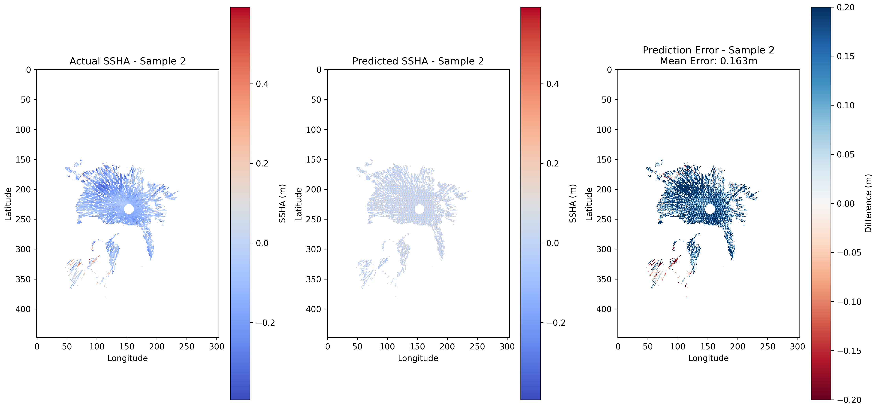
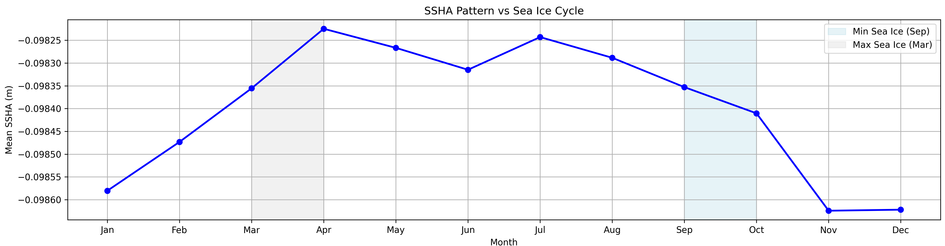
Analysis of Arctic Sea Surface Height Anomalies Using Machine Learning and Deep Learning Techniques
Ali Owji
Introduction
Deep Learning Methodology
Temporal & Seasonal Analysis
Conclusion
.
Arctic Ocean's sea surface height (SSH) is a crucial indicator of climate change impacts
Changes in SSH reflect key processes: sea ice melt, freshwater input, and ocean circulation
ICESat-2 satellite data provides high-resolution SSH monthly measurements since 2018 (70 measurements)
Machine learning and deep learning approaches can help understand complex spatial-temporal patterns
Convolutional neural network (CNN) and long short-term memory (LSTM) are used in this study to analyze SSH anomalies (SSHA) in the Arctic
The CNN model's performance reveals challenges in spatial SSHA prediction, showing signs of overfitting with low training errors (~5cm MAE) but significantly higher spatial prediction errors (~16cm). This discrepancy suggests difficulty in generalizing to new spatial patterns in the complex Arctic environment.
The LSTM analysis using PCA identified five distinct temporal patterns, with the primary pattern explaining 39.9% of variance, suggesting strong recurring behaviors in Arctic SSHA. However, the physical interpretation of these patterns requires careful consideration, as they may represent combinations of various oceanographic processes rather than individual phenomena.
Analysis of SSHA variation against the sea ice cycle reveals counterintuitive relationships. During maximum sea ice extent in March (known from satellite observations), SSHA values increase rather than showing expected depression from ice formation. Similarly, during minimum ice extent in September, SSHA values decrease instead of showing expected higher water levels from melted ice. These discrepancies suggest that the relationship between sea ice and SSHA is more complex than simple freeze-melt dynamics, likely influenced by multiple factors including ocean circulation patterns, atmospheric forcing, and regional water mass distribution.
Figure 3: Methodology pipeline showing deep learning analysis.
Figure 6: LSTM autoencoder training and validation loss over 10 epochs. The model shows rapid convergence within the first 2 epochs, with both training and validation loss decreasing to very low values (~0.0002).
Predictive Analysis
LSTM Overview
Autoencoder architecture
Input sequence length: 12 months
Two LSTM layers: 128 -> 64 units
Dense bottleneck layer: 32 units
Decoder: RepeatVector + Two LSTM layers (64 -> 128)
TimeDistributed Dense layer for output
Model Configuration
Sequence-to-sequence prediction.
Adam optimizer
Mean squared error (MSE) loss function
Batch size: 32 samples
Training
Early stopping (patience: 5 epochs)
Maximum of 20 epochs
A
B
Figure 4: Training metrics for the CNN model over 30 epochs. The model's loss, 4A, and Mean Absolute Error (MAE), 4B, show convergence, with both training and validation metrics steadily decreasing and stabilizing. The validation performance tracks closely with training performance with the training and validation set converging at a loss of .05.
Future Directions
Implement cross-validation for Random Forest to ensure robust performance metrics
Explore density-based clustering (DBSCAN/HDBSCAN) better suited for spatial oceanographic patterns
Implement proper three-way data splits (train/validation/test) for both CNN and LSTM models
Add regularization techniques to address CNN overfitting
Experiment with different CNN architectures to reduce spatial prediction errors
Extend LSTM sequence length analysis beyond 12 months
Investigate bidirectional LSTM architectures for improved temporal patterns
Develop hybrid CNN-LSTM model for spatiotemporal prediction
Research physical mechanisms behind PCA-identified temporal patterns
Investigate discrepancies between SSHA patterns and known ice extent cycles
Study influences of ocean circulation, atmospheric pressure, and wind patterns
Incorporate additional environmental variables and satellite data sources
Validate findings against other Arctic oceanographic studies
Figure 1: Spatial distribution of Sea Surface Height Anomalies (SSHA) in the Arctic Ocean for March 2020. Blue regions indicate lower sea surface heights relative to the mean, while red regions show elevated surfaces. The pattern reveals the complex interplay of ocean dynamics and ice conditions across the Arctic basin.
CNN Overview
Encoder-Decoder (U-Net style) architecture
Convolutional layers: Extract low & high-level spatial features
Pooling layers: Reduce dimensionality while preserving key spatial features
BatchNormalization layers for training stability
Skip connections between encoder and decoder
Model Hyperparameters
Sequential convolutional layers (64→128→256→128→64 filters)
.001 learning rate
Adam optimizer
Mean squared error (MSE) loss function
kernel size: 3x3
padding: same to preserve spatial dimensions
Training Hyperparameters
Batch size: 32
Early stopping (patience: 5 epochs)
Maximum of 50 epochs
Initial Machine Learning
Figure 7: Main temporal patterns identified by the LSTM autoencoder and analyzed using Principal Component Analysis (PCA). The analysis discovers five distinct SSHA patterns, with Pattern 1 explaining 39.9% of the variance. Blue lines show original sequences, and red dashed lines show the model's reconstructions. Each pattern represents different temporal behaviors in Arctic sea surface height variations over 12-month periods.
A
B
References
Figure 2 are the results from k-means clustering and random forest model. 2A is an elbow plot run on 15 clusters. 2B shows the feature importance of for the random forest model for the 6 features with longitude having the highest importance.
Arctic sea ice reaches a below-average maximum. (n.d.). National Snow and Ice Data Center. Retrieved December 4, 2024, from https://nsidc.org/sea-ice-today/analyses/arctic-sea-ice-reaches-below-average-maximum
Kiest, K. (2022, September 21). Sea Ice. NOAA Arctic. https://arctic.noaa.gov/report-card/report-card-2022/sea-ice/
.Morrow, R., Fu, L.-L., Rio, M.-H., Ray, R., Prandi, P., Le Traon, P.-Y., & Benveniste, J. (2023). Ocean Circulation from Space. Surveys in Geophysics, 44(5), 1243–1286. https://doi.org/10.1007/s10712-023-09778-9
K-means
K-means clustering revealed continuous rather than discrete SSHA patterns
Weak cluster separation (silhouette score: 0.1852) suggests need for density-based approaches
Random Forest
Model achieved 5cm mean absolute error but only explained 55% of variance
Geographic position (longitude, distance from pole) most influential
A
B
C
Figure 5 shows CNN predictions of Arctic SSHA using 14 test files (20% of the dataset). 5A and 5B compare actual vs predicted SSHA values in meters, while 5C visualizes the prediction error. The mean error of 0.163m suggests the model captures broad patterns but struggles with fine-scale features, particularly in the central Arctic Ocean. Land areas are masked to focus on meaningful sea surface predictions.
Figure 8: Annual cycle of mean Arctic SSHA values by month, with shaded regions indicating minimum (September) and maximum (March) sea ice periods. Values show consistent deviations below the mean sea surface height, with peak negative anomalies in winter months and relatively higher values during spring and summer.
Code Carbon
0.004156 kg CO2eq total emissions across all model training
All computations performed on Apple M2 Pro, tracked using CodeCarbon v2.8.0

